Slide 1
Review:Chapter 1 The Big Picture
Computer History and development
Layers of Computing System

Slide 2
1.1 Computing Systems

Slide 3
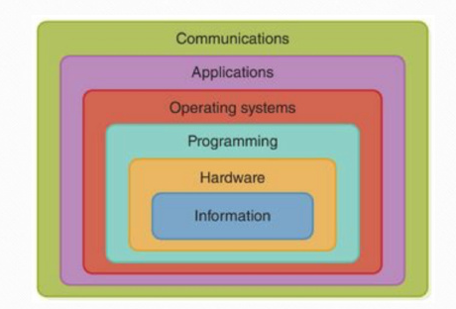
Layers of Computing System
To share information and resource
To use the computer to solve specific real-world problems with programs
To help manage the computer’s resource
To accomplish computations and manage data with instructions
The physical hardware of a computer system
The way to represent information on computer

Slide 4
Abstraction
An abstraction is a mental model
A way to think about something, which removes or hides complex details
Key to computing
The layers of computing system embody the idea of abstraction

Slide 5

慕课视频片段
视频名称：1.2.1 The nature and characteristics of computational thinking
温馨提示：此视频框在点击“上传手机课件”时会进行转换，用手机进行观看时则会变为可点击的视频。此视频框可被拖动移位和修改大小
Computational Thinking

Slide 6
1.2 The History of Computing

Slide 7
慕课视频片段
视频名称：1.1.1 Computer history and development (Part I)
温馨提示：此视频框在点击“上传手机课件”时会进行转换，用手机进行观看时则会变为可点击的视频。此视频框可被拖动移位和修改大小

Slide 8
慕课视频片段
视频名称：1.1.2 Computer history and development (Part II)
温馨提示：此视频框在点击“上传手机课件”时会进行转换，用手机进行观看时则会变为可点击的视频。此视频框可被拖动移位和修改大小

Slide 9
Key Terms
Abstraction
Computer system
通过交互解决问题的计算机硬件、软件和数据
Computer software
提供给计算机执行的指令的程序
Computer hardtware
组成计算机系统的物理元件

